Slide 1
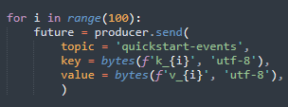
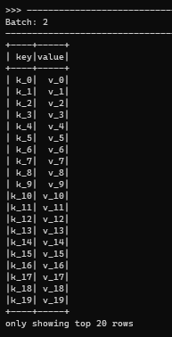
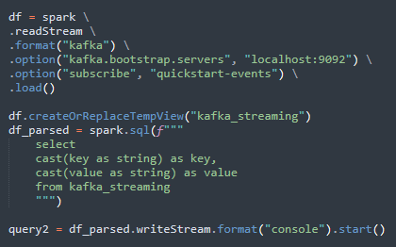
sending messages to kafka by python
show messages in spark streaming dataframe
reading messages from kafka to a spark dataframe

